Slide 1
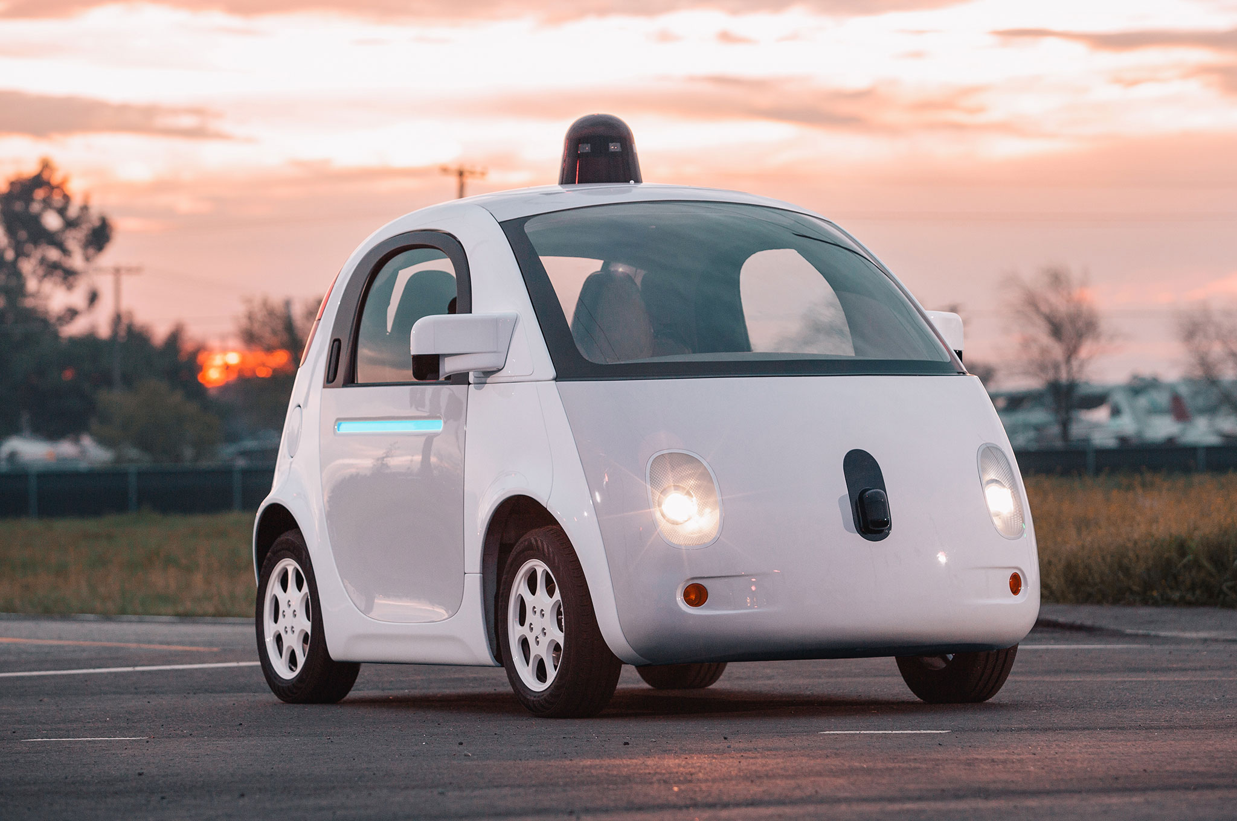
PEACE Passenger Emotion Analysis for Commute Enhancement
'; DROP TABLE TEAM; --
Jinwoo Yom
Chaeyoon Lee
Luv Sampat
Mohannad Ibrahim

Slide 2

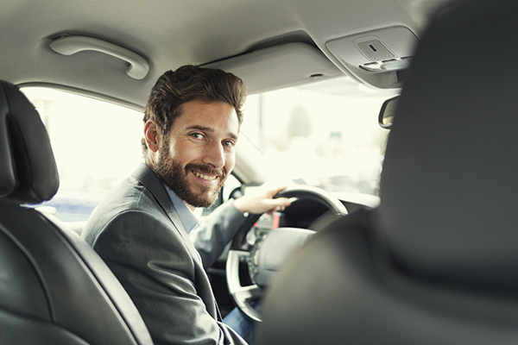

Problem
Public Acceptance
Ride Quality
Interface
How to gain and retain it?
What defines a ride quality? How can a car estimate that?
What interface and technology to use?

Slide 3


Slide 4
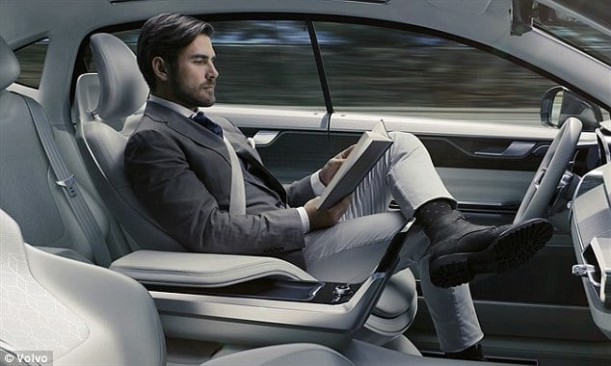


Solution
Detect
Capture
Facial detection of multiple passengers
Save images when emotions vary
Analyze
Action
Automating the control of vehicle functions in real-time, we improve ride quality and thereby increase acceptance in society.
Output the emotion with precision
Slow down, engage with passenger, turn the music off, etc.

Slide 5
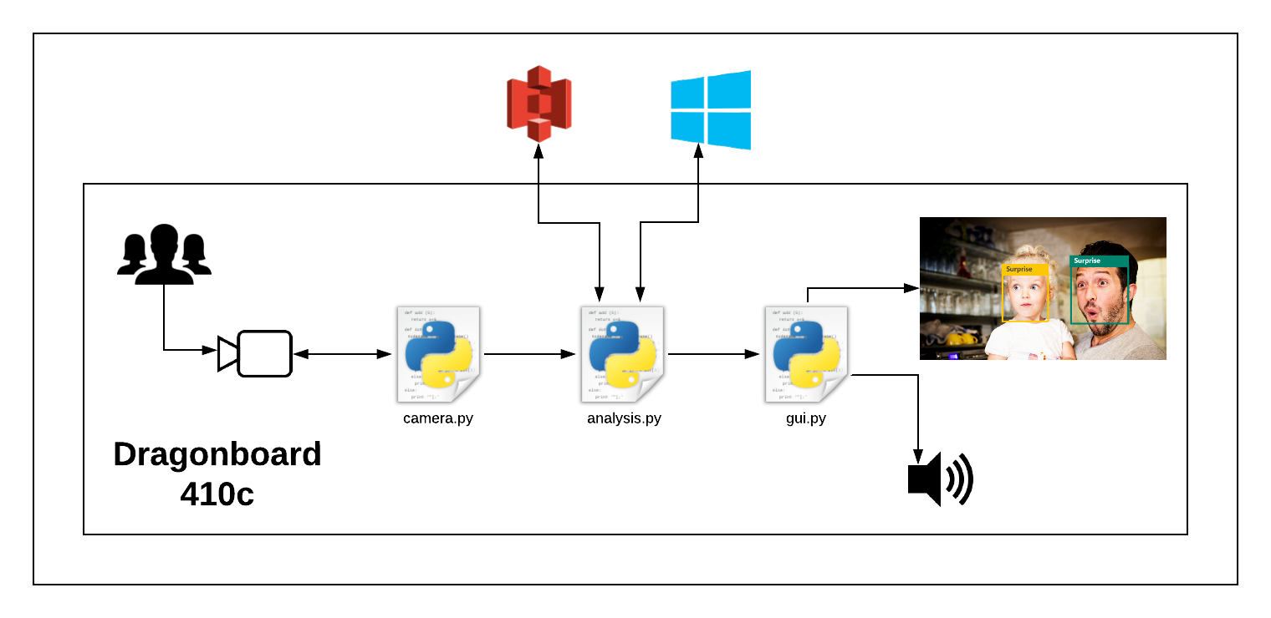
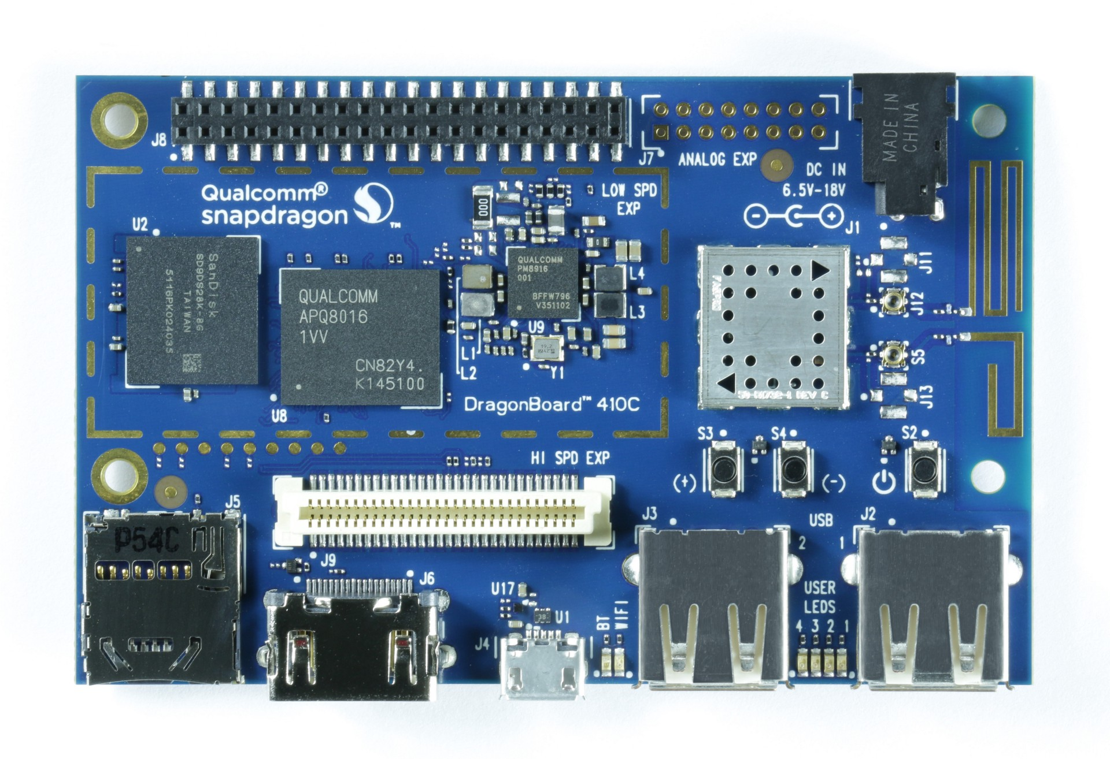
Overview

Slide 6
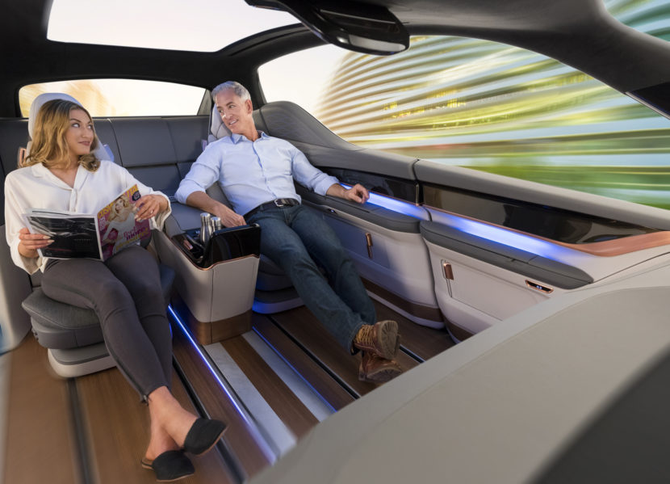
Future Plans
Smarter route selection
Eliminate false positives
Qualcomm’s Drive Data Platform
Emotions in the dark
More applications

